Slide 1
FUNCTIONS

Slide 2
FUNCTIONS
In JavaScript, a function allows you to define a block of code, give it a name and then execute it as many times as you want.
Simply its a block of code designed to perform a particular task.
A JavaScript function is executed when "something" invokes it (calls it).

Slide 3
Function Definition
A JavaScript function can be defined using function keyword.
A JavaScript function is defined with the function keyword, followed by a name, followed by parentheses ().
Function names can contain letters, digits, underscores, and dollar signs (same rules as variables).
The parentheses may include parameter names separated by commas: (parameter1, parameter2, ...)
The code to be executed, by the function, is placed inside curly brackets: {}

Slide 4
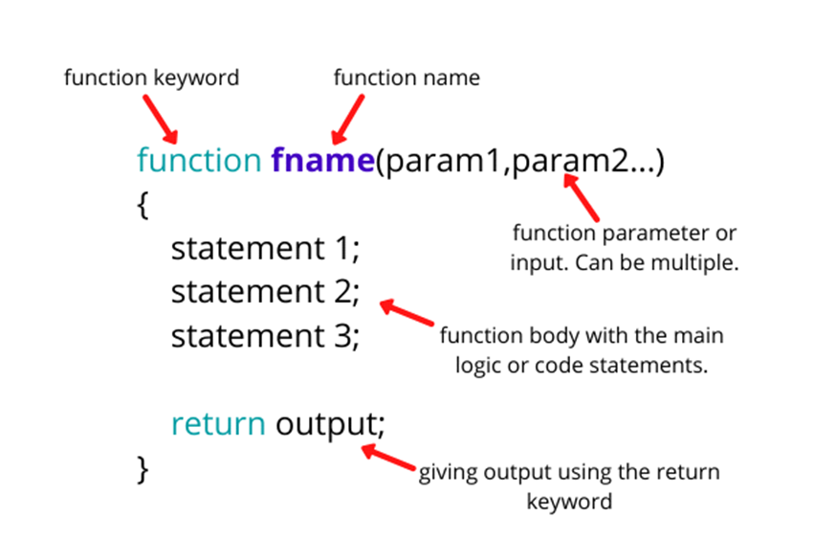

Slide 5
Function Invocation
The code inside the function will execute when "something" invokes (calls) the function:
When an event occurs (when a user clicks a button)
When it is invoked (called) from JavaScript code Automatically (self invoked)
//calling a function
<function-name>();

Slide 6
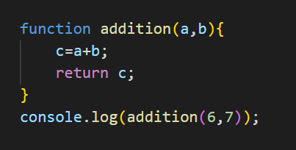
Function Return
When JavaScript reaches a return statement, the function will stop executing.
If the function was invoked from a statement, JavaScript will "return" to execute the code after the invoking statement.
Functions often compute a return value. The return value is "returned" back to the "caller":
Eg:

Slide 7
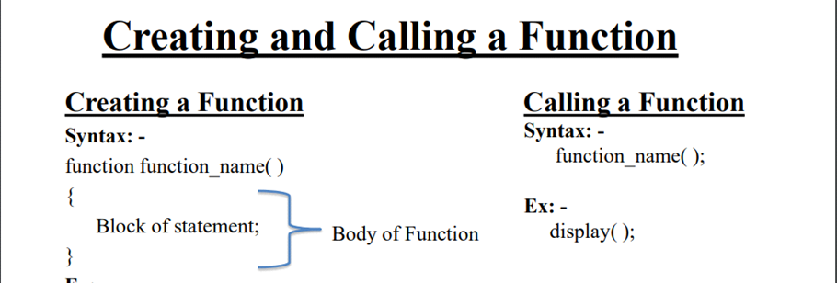

Slide 8
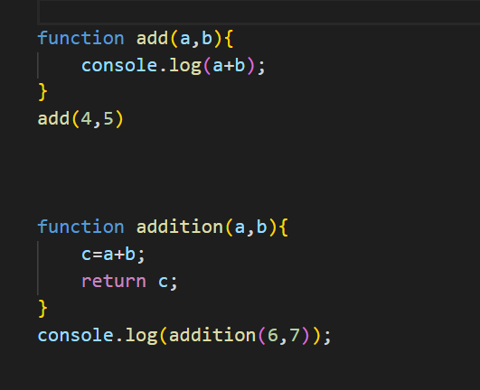
Function Syntax
//defining a function
function <function-name>()
{
// code to be executed
};

Slide 9
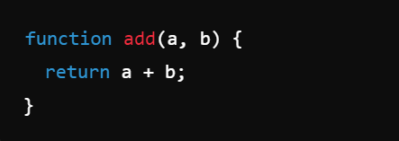

Arrow Functions
Arrow functions, introduced in ECMAScript 6 (ES6), provide a more concise syntax for writing functions in JavaScript.
They differ from traditional function expressions in several ways:
Syntax
Traditional Function:
Arrow Function:
If the function has only one expression, the return keyword and curly braces can be omitted.

Slide 10
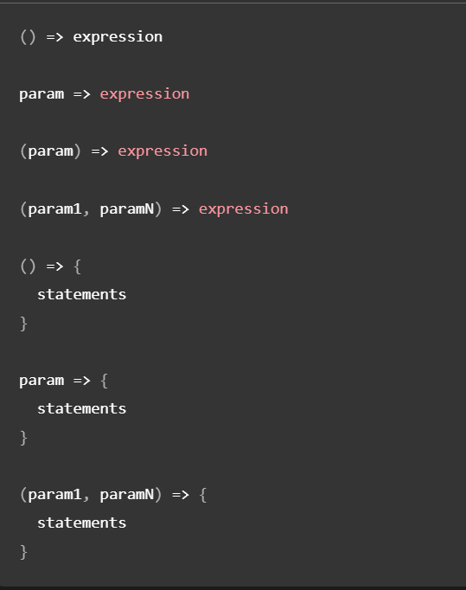
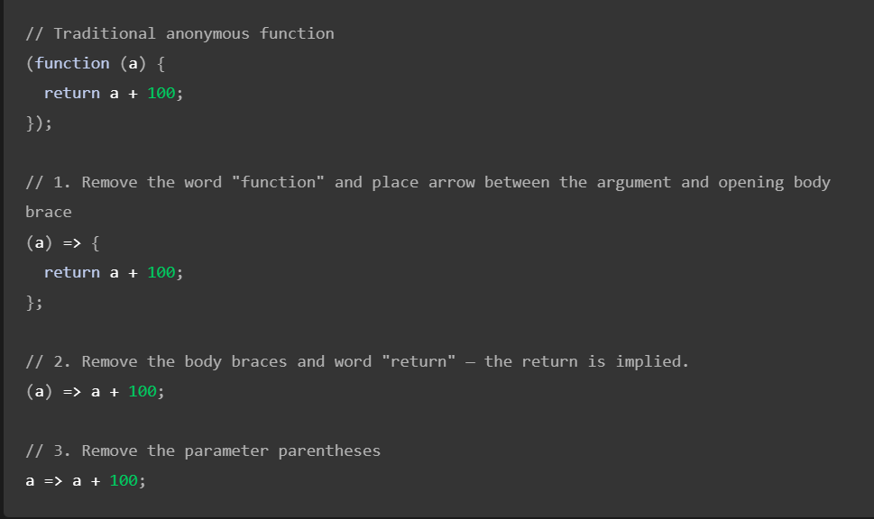

Slide 11
Types Of Functions
Named function
Anonymous Functions
Recursive Functions

Slide 12
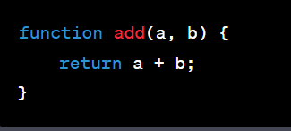
1 Named function
These are functions defined with a name that can be called by that name.
Named functions are useful if we need to call a function many times to pass different values to it or run it several times.

Slide 13
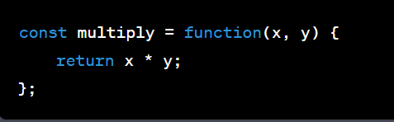
2 Anonymous Functions
These are functions without a name and are often used as arguments to other functions or as immediately invoked function expressions (IIFE).

Slide 14
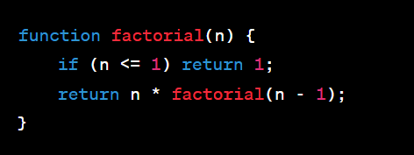
3 Recursive Functions
Functions that call themselves to solve a problem by breaking it down into smaller, similar subproblems.

Slide 15
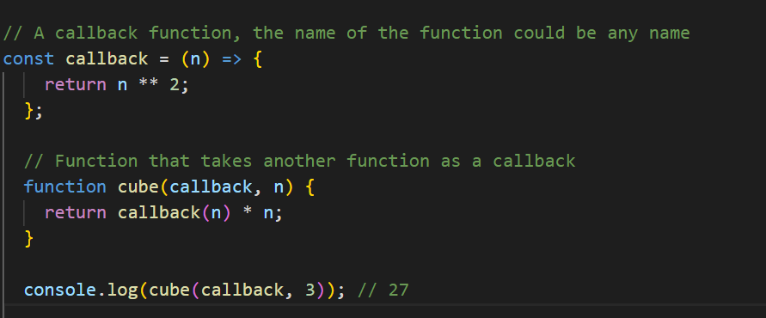
4 Higher Order Function
Higher order functions are functions which take other function as a parameter or return a function as a value. The function passed as a parameter is called callback.
Callback
A callback is a function which can be passed as parameter to other function. See the example below.

Slide 16
Setting time
In JavaScript we can execute some activities in a certain interval of time or we can schedule(wait) for some time to execute some activities.
setInterval
setTimeout

Slide 17
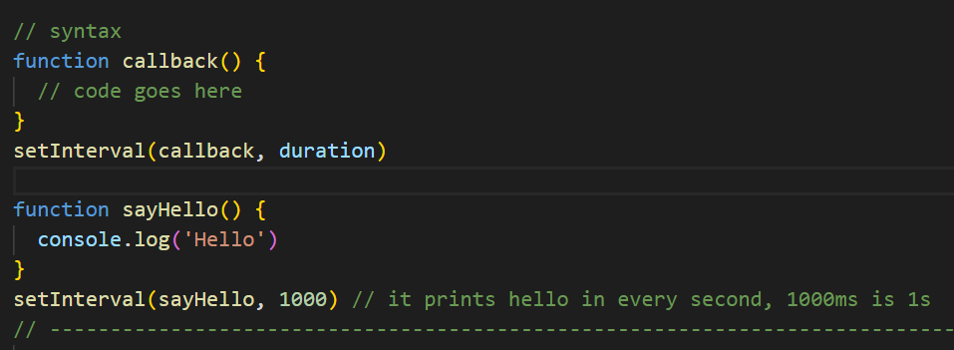
Setting Interval using a setInterval function
In JavaScript, we use setInterval higher order function to do some activity continuously with in some interval of time.
The setInterval global method take a callback function and a duration as a parameter.
The duration is in milliseconds and the callback will be always called in that interval of time

Slide 18
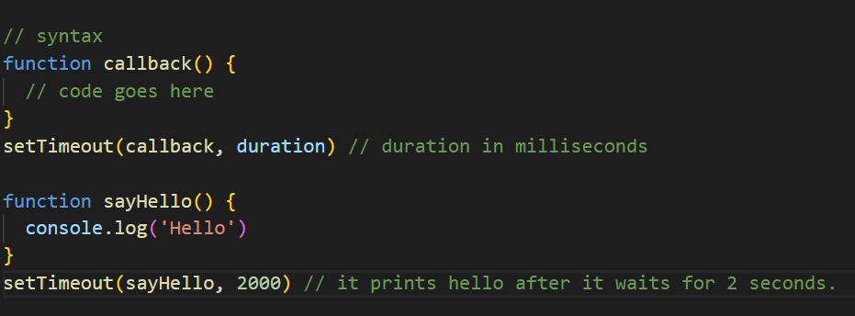
Setting a time using a setTimeout
In JavaScript, we use setTimeout higher order function to execute some action at some time in the future.
The setTimeout global method take a callback function and a duration as a parameter.
The duration is in milliseconds and the callback wait for that amount of time.

Slide 19
Tasks
Write a program to find the area of a triangle using function
Write a JavaScript function that accepts a number as a parameter and check the number is prime or not.
Write a JavaScript function that checks whether a passed string is palindrome or not?
Write an anonymous function that takes two numbers as arguments and returns their product.
Create an arrow function that squares a given number.
Write a recursive function in JavaScript to calculate the nth Fibonacci number. The Fibonacci sequence is defined as follows: the first two numbers are 0 and 1, and each subsequent number is the sum of the two preceding ones.

Slide 20
7. What is the difference between function parameters and arguments?
8. What is the purpose of the return statement in a function, and what does it do?
9. What are the differences between arrow functions and regular functions in JavaScript?
10. What is the difference between local and global scope in JavaScript functions?
11. Create a Function to Convert Celsius to Fahrenheit using arrow function.
12. Create a Function to print Greeting Message using arrow function.

Slide 21
Thank You

